Slide 1

Walmart
Customer Engagement Analysis
September 2021
Team Chernoff
1

Slide 2





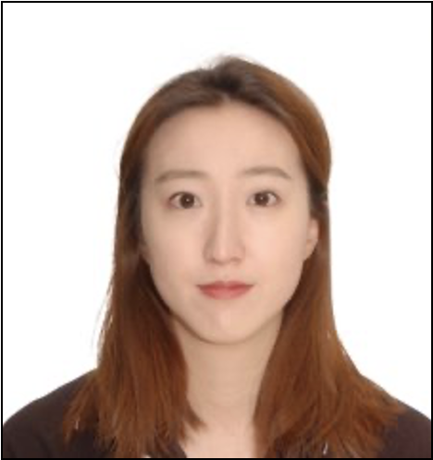


Meet The Team
Leon Joulakian
Jiamin Mei
Laleh Keramati
Isaac Ng
Akshay Malhotra
Wendy Fang
Shitangshu Maity
Jenny Oh
2

Slide 3
Agenda
Industry & Business Overview​
Marketing Challenges
Data Exploration​ & Engineering
Models​
Results
Recommendations
3

Slide 4
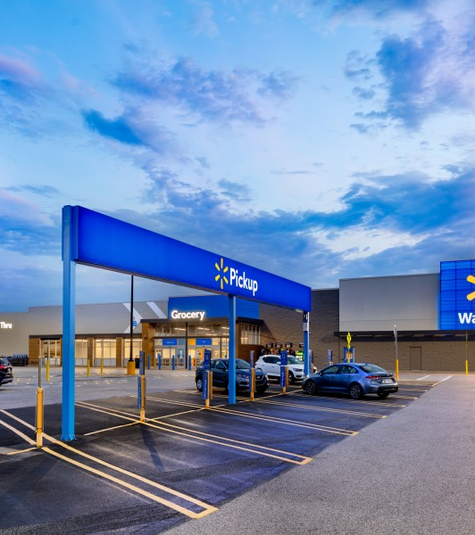
Industry Overview
Walmart is one of the top grocery leaders by market share and market cap
The grocery retail industry is highly competitive and concentrated
Their value to consumers is to offer the lowest price possible
They use a multitude of marketing channels to reach their customers
4

Slide 5

Marketing Challenges
The strong competition in the retail industry means customer loyalty is fleeting
The marketing team has advised us that their last marketing campaign was not as effective as expected
What they want to know:
What kind of customer is more likely to respond to marketing campaigns?
How many of those respondents are expected to spend?
5

Slide 6
2240 Customers
28 Variables
5 unique Education variables
8 unique Marital_Status variables
3 years of data
9 countries
Data Overview
Data Buckets | Variables
Demographics | Year_Birth, Education, Marital_Status, Income, KidHome, TeenHome
Customer History | Dt_Customer, Recency
Grocery Spend | MntWines, MntFruit, MntMeatProducts, MntFishProducts, MntSweetProducts, MntGoldProds
Marketing Channels | NumWebPurchases, NumCatalogPurchases, NumStorePurchase
Responses to Prior Campaigns | AcceptedCmp, Response, Complain
Location | Country
6

Slide 7
Data Engineering
Recoded categorical variables for Marital_Status and Education
02
Created dummy variables for Marital_Status and Education
04
Aggregated grocery spend variables to create Total_Spend
Transformed variables to create Age and Enrollment_Length
01
Used median to address missing Income values
03
7

Slide 8
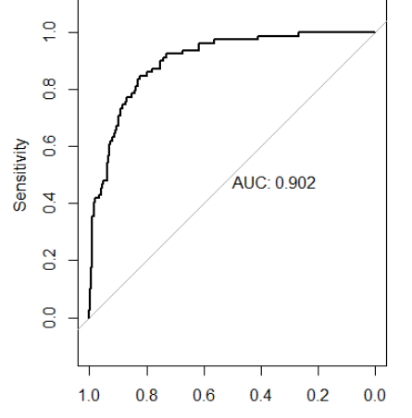
Model #1 - Logistic Regression
What are the characteristics of customers who respond?
Positively Significant Coefficients | Negatively Significant Coefficients
Education Level Time since campaign enrollment Acceptance of offers from prior campaigns | Marital Status Time since last purchase # of small children at home # of teenagers at home
8
Notes:
# Akshay – AUC CURVE BETTER RESOLUTION

Slide 9
Model #2 - Linear Regression
What customer characteristics likely drives spend?
Model | MSE | R2
LR with transformation | 0.286 | 86.01%
LR with transformation & sig. variables | 0.274 | 85.85%
Linear Regression (LR) | 77152.7 | 80.86%
Positively Significant Coefficients | Negatively Significant Coefficients
Income / Education Level Time since last purchase Time since campaign enrollment Acceptance of offers from prior campaigns | # of small children at home # of teens at home
9

Slide 10



Result Matrix
Cash Cows | Stars
Question Marks | Dogs
High Spend
Low Spend
No Response
Response
10

Slide 11
Result Matrix
Cash Cows (32%): Higher income & education Live alone Have kids or teens at home Recently.enrolled.in program. | Stars (9%): Higher income & education Live alone No kids or teens at home Not new to the program.
Question Marks (53%): Lower income & education Live with a partner Have kids or teens at home Recently.enrolled.in program | Dogs (6%): Lower income & education Live with a partner No kids or teens at home Not new to the program.
High Spend
Low Spend
No Response
Response
11

Slide 12
Recommendations
 | Non-Responsive | Responsive
High Spenders | Studies needed to identify preferred marketing channel | Maintain current levels of offers to ensure these customers return.
Low Spenders | Identify cross-sell opportunities using frequently purchased items | Customize offerings to incentivize larger purchases
Successful implementation should result in higher campaign response rates and grocery spend.
Key success metrics include:
Percentage increase in response rate vs. current rate (15%)
Percentage increase in total grocery spend vs. target (10%)
Number of high spenders vs. current number (334)
12

Slide 13
Questions?
13

Slide 14
Thank You!
14

